Slide 1
Hadoop Distributed File System
Pravin Y Pawar

Slide 2
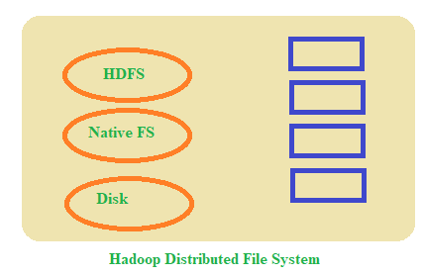
HDFS
Storage component of Hadoop
Distributed File system
Based on Google File system
Optimized for high throughput
Native replication available
Re-replicates the blocks if the node fails
Works better with the files with large size
Sits on top of native file system
Block structured file
Default replication factor : 3
Default block size : 128MB (Hadoop 2 and 3) , 64MB(Hadoop 1)

Slide 3
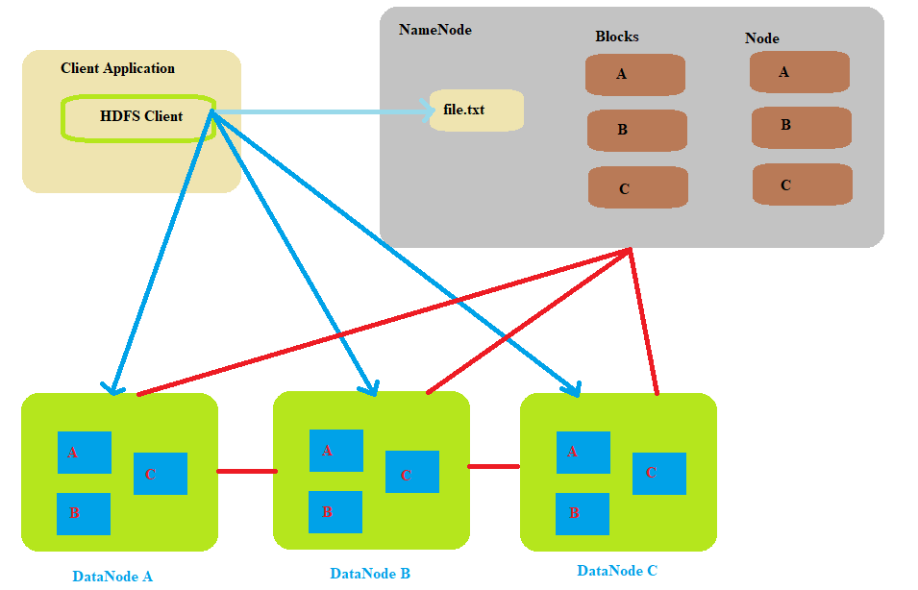
HDFS Architecture
Client application
interacts with NameNode for metadata related activities
Interacts with DataNode to read and write files
DataNodes interacts with each other for pipeline reads and writes.

Slide 4
HDFS Daemons
NameNode
HDFS breaks a large file into pieces called chunks
Rack is collection of DataNodes within the cluster
NameNode
Single instance per cluster
uses RackID to identify DataNodes in the rack
Keeps tracks of blocks of file as its placed on various nodes
Manages file-related operations as read, write, create and delete

Slide 5
NameNode (2)
NameNode working
Main task to manage HDFS Namespace
collection of files in the cluster
Contains mapping of blocks to file, file properties
all stored in file called FsImage
EditLog (transaction log)
Used to record every transaction that happen to file system metadata
When NameNode starts up
it reads FsImage and EditLog from disk
applies all transactions from the EditLog to the in memory version of FsImage
Then flushes out new version of FsImage on disk
Truncates the old EditLog as its changes are applied on the new FsImage

Slide 6
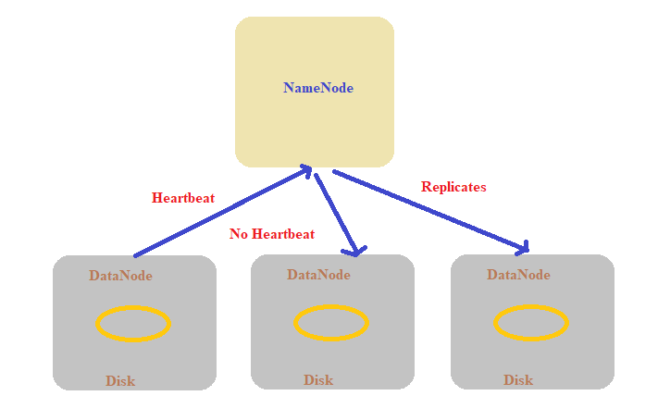
DataNode
Multiple DataNodes per cluster
During pipeline read and write , DataNodes communicates with each other
DataNode continuously sends heartbeat to NameNode
To ensure the connectivity with NameNode
If no heartbeat message from DataNode, NameNode replicates that DataNode within the cluster

Slide 7
Secondary NameNode
Takes a snapshot of HDFS metadata at intervals specified in Hadoop configuration
Better to separate out the NameNode and Secondary NameNode
as the memory requirements are same for both
In the case of failure of NameNode,
The secondary NameNode can be configured manually to bring up the cluster
But it does not record any real-time changes that happen to the HDFS metadata

Slide 8
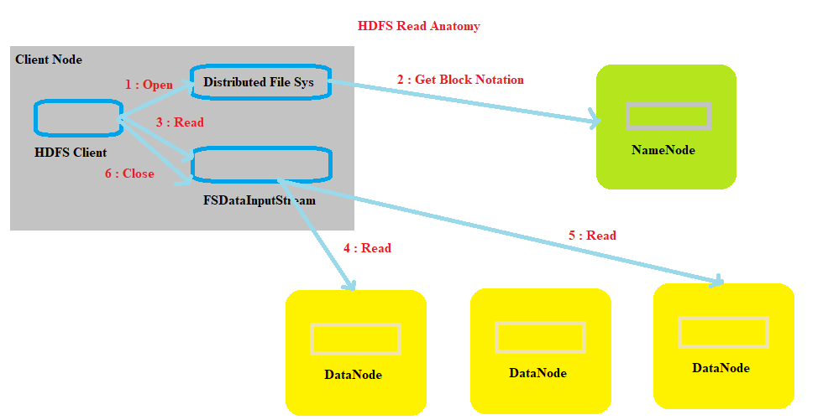
FileRead

Slide 9
FileRead - steps
Client opens the file that it wishes to read from by calling open() on DistributedFileSystem
DistributedFileSystem communicates with NameNode to get location of data blocks. NameNode returns the addresses of DataNodes on which blocks are stored. DistributedFileSystem returns FSDataInputStream to client to read from file.
Client then calls read() on the stream, which has addresses of DataNodes for first few blocks of file, connects to the closest DataNode for the first block in file
Client calls read() repeatedly to stream the data from DataNode
When end of block is reached, stream closes the connection with DataNode. It repeats the steps to find the best DataNode for the next blocks.
When the client completes the reading of file, it calls close() on the stream to close the connection.

Slide 10
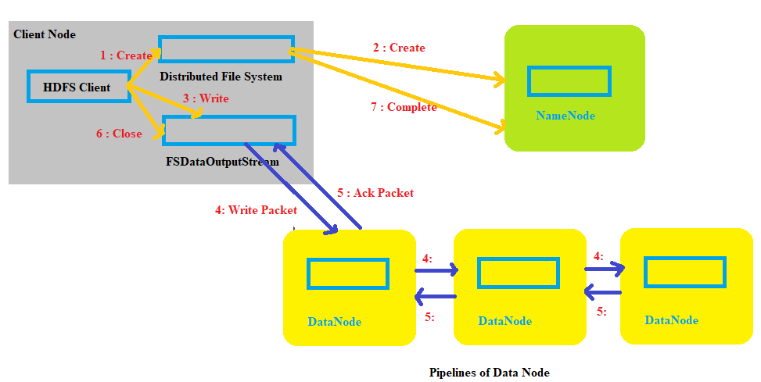
FileWrite

Slide 11
FileWrite - steps
Client calls create() on DistributedFileSystem to create a file
RPC call to NameNode happens through DistributedFileSystem to create new file. NameNode performs checks to create a new file. Initially, NameNode creates a file without associating any data blocks to the file. The DistributedFileSystem returns an FSDataOutputStream to client to perform write.
As the client writes data, data is split into packets by FSDataOutputStream, which is then written to the internal queue. DataStreamer consumes the data queue. DataStreamer requests NameNode to allocate new blocks by selecting a list of suitable DataNodes to store replicas. This is pipeline.
DataStreamer streams packets to first DataNode in the pipeline. It stores packet and forwards it to Second DataNode and then Second node transfer it to Third DataNode.
FSDataOutputStream also manages a “Ack queue” of packets that are waiting for the acknowledgement by DataNodes. A packet is removed from the queue only if it is acknowledged by all the DataNodes in the pipeline
When the client finishes writing to the file, it calls close() on the stream
This flushes all the remaining packets to DataNode pipeline and waits for relevant acknowledgements before communicating the NameNode to inform the client that the creation of file is complete.

Slide 12
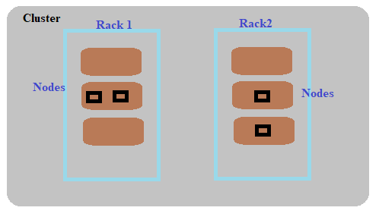
Replica Placement Strategy
As per Hadoop replica placement strategy,
First replica is placed on the same node as the client
Second replica is placed on a node that is present on different rack
Third replica is placed on same rack as second but on a different node
Once the replica locations are set, pipeline is built
Shows good reliability

Slide 13
Thank You!
Reference :
Big Data and Analytics by Acharya, Chellappan
In our next session:

